Slide 1
HTML 5
CLASS 3

Slide 2
What is HTML 5
HTML 5 was introduced in 2008 and officially adopted as standard in 2014
It included many improvements over HTML 4, most notable in the new page structures(aka new html tags/elements) and the video and audio standards which will work across platform and across browser and well a graphical content.
New in HTML 5
<main>
<section>
<article>
<header>
<footer>
<aside>
<nav>
<figure>
<video>
<audio>
<canvas>

Slide 3
HTML 5
HTML 5 has significant chances and standardization of the DOM.
What is the DOM?
Document object model(DOM) is the programmatical representation of the HTML Document allows you to change and manipulate the document via function and methods.
The DOM is a tree structure. You can start at the document and via a parent child relationship, access child elements or the parent element.
These elements can also be called nodes.
html
head
title
body
h1
div
text
em
img
p
text
text

Slide 4
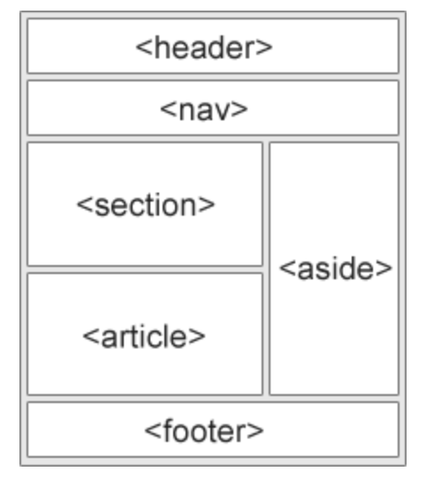
HTML 5 Structures
New HTML Elements
New elements were introduced to make the structure of a page better and in order to better describe a elements content.
These new elements are also used to also make screen readers better for visually impaired people.
These new tags give more purpose and structure to your content

Slide 5
<header>
A <header> element typically contains:
one or more heading elements (<h1> - <h6>)
logo or icon
authorship information
<header> is a block element nearly identical to a <div>
https://www.w3schools.com/tags/tag_header.asp
<header>
<img src="./company_logo.png" alt="My News Station Logo"/>
<h1>Main page heading here</h1>
<h3>Posted by John Doe</h3>
</header>

Slide 6
<footer>
A <footer> element typically contains:
General information
How to contact
Copyright information
Address maybe
Or related links
<footer> is a block element nearly identical to a <div>
https://www.w3schools.com/tags/tag_footer.asp
<footer class="footer-container">
<div class="footer-social-openings">
<a href="https://www.facebook.com/HeavinCarpets/"><span class="fab fa-facebook-square"></span></a>
</div>
<div class="footer-openings">
<div>Mon - Sat: 9:30am - 5:00pm</div>
<div>Sun: Closed</div>
</div>
</footer>

Slide 7
<article>
An article tag is used to enclose the content of the page. This content could be a news article, a blog post, forum post, or even comment on articles or sidebar widgets having a heading.
Typically an article would contain a header and a paragraph or sections
<article> works the same as a <div>
It should have content and it is a block element
https://www.w3schools.com/tags/tag_article.asp
<article>
<h2>Browsers</h2>
<p>Google Chrome is a web browser developed by Google. Chrome is the most popular browser … and so on</p>
</article>
<article>
<h2>Weather</h2>
<p>Tomorrows forecast and so on</p>
</article>

Slide 8
<section>
You may get confused between the usage of a section and an article tag. However, note that while article tag is used for enclosing main contents of the page, a section tag is used to enclose any sub-content, or a sub-section of a website. For example: A web site’s home page could be split into sections for an introduction, news items and contact information.
<section> works the same as a <div>
It should have content and it is a block element
https://www.w3schools.com/tags/tag_section.asp
<h2>About Browsers</h2>
<section>
<h2>Google Chrome</h2>
<div>Google Chrome is a web browser developed by Google. Chrome is the most popular browser … and so on</p>
</section>
<section>
<h2>Mozilla Firefox</h2>
<p>Mozilla Firefox is an open-source web browser developed by Mozilla.</p>
</section>

Slide 9
<aside>
As the name suggests, an aside tag is used for additional content which may not be required to depict the meaning of the main content. For example, an aside can be used for sidebar, comments section, pull-quotes, glossary, advertisements, footnote etc.
https://www.w3schools.com/tags/tag_aside.asp

Slide 10
<nav>
A <nav> nav tag should be used for major navigational blocks (menus). You may use more than one nav blocks in an HTML5 page but it is better to use it for the primary menu. tag should be used for major navigational blocks (menus). You may use more than one <nav> blocks in an HTML5 page but it is better to use it for the primary menu.
https://www.w3schools.com/tags/tag_nav.asp

Slide 11
<main>
The <main> tag specifies the main content of a document.
The content inside the <main> element should be unique to the document. It should not contain any content that is repeated across documents such as sidebars, navigation links, copyright information, site logos, and search forms.
There must not be more than one <main> element in a document. The <main> element must NOT be a descendant of an <article>, <aside>, <footer>, <header>, or <nav> element.
https://www.w3schools.com/tags/tag_main.asp

Slide 12
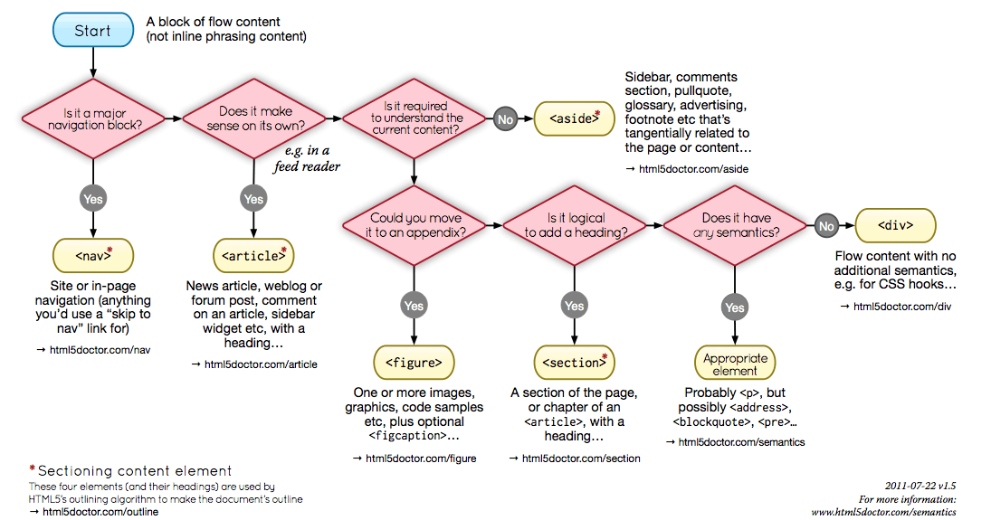
Deciding on which element

Slide 13
<input>
<input> is the only way of a user inputting data to a webpage.
Inputs can have many types and can be configured in many ways based on the data they need to gather.
Input is a self closing tag or open tag. It does not take content
<input type="button">
<input type="checkbox">
<input type="color">
<input type="date">
<input type="datetime-local">
<input type="email">
<input type="file">
<input type="hidden">
<input type="image">
<input type="month">
<input type="number">
<input type="password">
<input type="radio">
<input type="range">
<input type="reset">
<input type="search">
<input type="submit">
<input type="tel">
<input type="text"> (default value)
<input type="time">
<input type="url">
<input type="week">

Slide 14
<input>
Required attributes
type – the type of input
There are more required attributes but that depends on the input type
Optional attributes but recommended
value – current value of the input
name – the name of the data e.g. email, firstName
placeholder – faded text to display when the input is empty
Other commonly used attributes
readonly
disabled
required

Slide 15
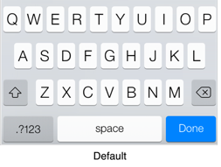
<input type=“text”>
<input type="text"/>
Text is the default. This is basically a free form input and means any character can be entered in the search box

Slide 16
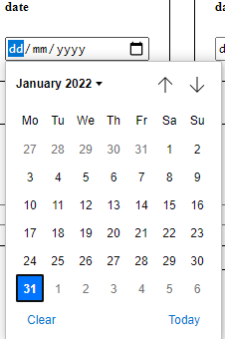
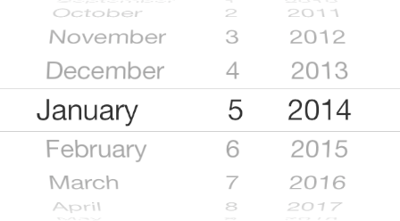
<input type=“date”>
<input type="date"/>

Slide 17
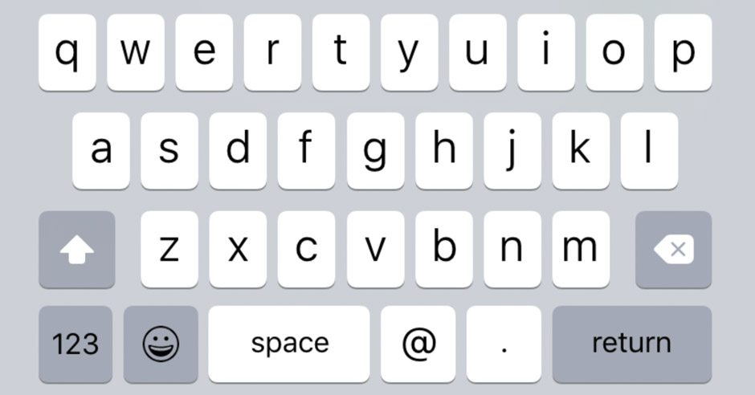
<input type=“email”>
<input type="email"/>

Slide 18
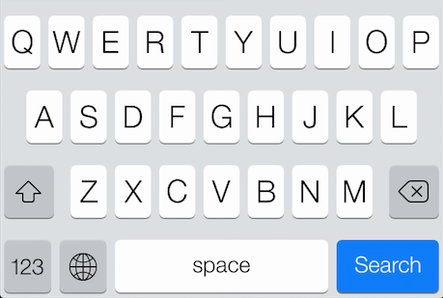
<input type=“search” />
<input type="search"/>

Slide 19
<label>
Labels are used in conjunction with inputs. They are not required but are recommended
Proper use of labels with the elements above will benefit:
Screen reader users (will read out loud the label, when the user is focused on the element)
Users who have difficulty clicking on very small regions (such as checkboxes) - because when a user clicks the text within the <label> element, it toggles the input (this increases the hit area).
Required attributes
For – the id of the input the element is for
<input type="checkbox" id="someId" name="adult" checked>
<label for="someId">Over 18?</label>

Slide 20
<form>
Form groups a collection of input to make a set of data
Forms can contain one or more of the following elements
<input>
<textarea>
<button>
<select>
<option>
<optgroup>
<fieldset>
<label>
<output>

Slide 21
<form>
Form Attributes
action – the URL/address to send the data on submit
autocomplete – Whether the browser should try auto complete fields if possible
method – “post” or “get” – how the data should be sent
target – Where to display the response – same as <a> target _black, _self….
There are two ways for sending data.
Allowing the form to do so
JavaScript – most common

Slide 22
Class work
<section>
<h3>Subscription Signup</h3>
<article>
<p>Signup to our weekly newsletter where we will follow a range of topics blah blah blah....</p>
<form>
Create a form to accept Name, email, Password, telephone number, file upload and a check box for “Receiving promotional Material”, include labels and placeholders
</form>
</article>
</section>

